Slide 1
Memories and Matrices
Suman Seth
Cornell University

Slide 2
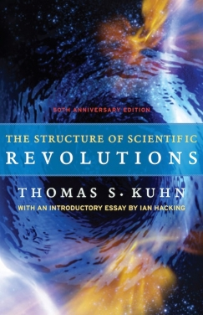
Thomas Kuhn (1922-1996)

Slide 3
Kuhn on Scientist’s Memories
“Often it turns out that not just their beliefs but their very modes of thought were different from the ones to which their discoveries gave rise…”
“Entry into a discoverer’s culture often proves acutely uncomfortable, especially for scientists…”

Slide 4
Kuhn: Normal and Revolutionary Science
Normal: Puzzle-solving within a paradigm
Revolutionary: Producing a new paradigm.
Normal science→ Anomalies→ Crisis→ Revolutions.
A Revolution ushers in a new normal scientific regime.

Slide 5
Thomas Kuhn, Interviewing Werner Heisenberg, 1963
By 1923, at least around Copenhagen—I’m not sure now it was then in Munich—it’s perfectly clear that what I will call a “crisis” exists and is recognized with respect to the problems in quantum mechanics. It’s clear in things that Bohr said, it’s clear at least by what Bohr thinks Born said, its clear for many people in that 1923 Bohr Heft of Naturwiss. and in other places. But it is by no means clear to me when that strong attitude came, how it developed, and more particularly, where it developed.

Slide 6
Leading the witness doesn’t always work… Kuhn interviews Dirac, 1962
TSK: Was there also that sense which again people speak of on the continent that something fundamental now had to come to get around these problems that were just not responding. That there was something fundamentally the matter?
D: I am not sure that that is so. They had the Bohr-Sommerfeld method of quantization and they thought it would have to be extended in some way…I don’t think people suspected that one would need such a complete revolution…It rather came as a surprise to me when Heisenberg’s ideas came out.

Slide 7
Memory is a tricky thing—particularly when talking of crisis… Heilbron interviews Pauling, 1964
P: But while Sommerfeld was here, he emphasised very strongly the anomaly of the inner quantum number and the outer quantum number—well at least he talked about the inner quantum number and the outer quantum number.
…
P: So that they introduce an azimuthal quantum number; in fact they introduce two azimuthal quantum numbers and then in talking about the s, p, d separation you use one and in talking about the fine structure splitting you use the other. And the question is how can you have two quantum numbers that describe the eccentricity of the orbit? It only has one eccentricity. So this was brought out, and my memory—I have to change my memory. Sommerfeld just talked along glibly about the inner azimuthal quantum number without giving anybody, any auditor, any impression that there was anything funny about it. [my italics]

Slide 8
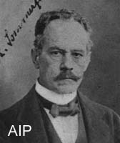
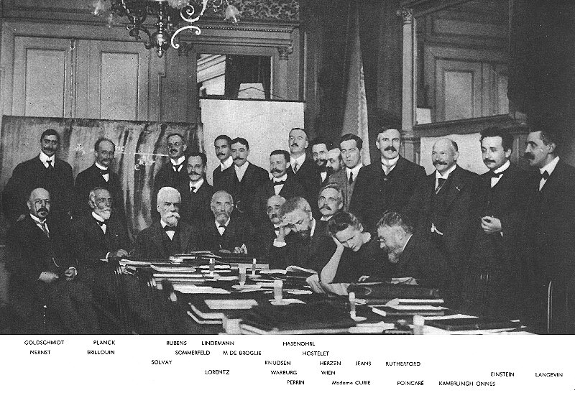
Arnold Sommerfeld (1868-1951)

Slide 9
Modellmässigkeiten (matters according to models) vs Gesetzmässigkeiten (matters according to empirical laws)

Slide 10
Modellmässigkeiten vs Gesetzmässigkeiten (Sommerfeld, 1919)
…at the moment we are at a loss with the modellmässigen (model-based) meaning of the line-multiplicities of the non-hydrogenic elements, in spite of repeated efforts from various sides. All the more valuable are all the lawful aspects [Gesetzmässigkeiten] that present themselves empirically for the line-multiplicities, above all when they are of such a radical and simple kind as those here at hand.

Slide 11
Atombau (3rd Ed., 1922)
I attach particular importance to the introduction of the inner quantum numbers and to the systematic arrangement of the anomalous Zeeman effects. The regularities that here obtain throughout are primarily of an empirical nature, but their integral character demands from the outset that they be clothed in the language of quanta. This mode of explanation, just like the regularities themselves, is fully established and is unique.

Slide 12
Sommerfeld, Innsbruck Lecture, September 1924
…I would like to say a few words about the soundness of our Modellvorstellungen. The difficulties that obtrude ever more clearly into atomic physics appear to me to lie less in an immoderate application of the quantum theory and much more in a perhaps immoderate belief in the reality of our Modellvorstellungen. Certainly the Hydrogen model functions correctly in all cases (except perhaps in strong magnetic fields) and certainly Bohr’s explanation of the chemical systematics of the periodic system is sound in general terms. But the phenomena are much simpler than one would expect according to the model... The atomic model would then be more of a calculational scheme [Rechenschema] than a state of reality [Zustandsrealität].

Slide 13
Pauli to Sommerfeld 6 December, 1924
I found it particularly beautiful in the presentation of the complex structure that you have left all modellmässig considerations to one side. The model-idea now finds itself in a difficult, fundamental [prinzipiellen] crisis, which I believe will end with a further radical sharpening of the opposition between classical and quantum theory. One now has the impression with all models, that we speak there a language that is not sufficiently adequate for the simplicity and beauty of the quantum world. For that reason I found it so beautiful that your presentation of the complex structure is completely free of all model-prejudices.

Slide 14
Summary: 4 Questions
History
Which sub-groups of the community saw a crisis?
Why? More specifically, how was this sense of crisis related to their technical practices?
Memory
3) Do WE regard the years before 1925 as a crisis because they were followed by a ‘revolution’?
4) Were WE to call the crisis into question, does this make the revolution less revolutionary?

Slide 15
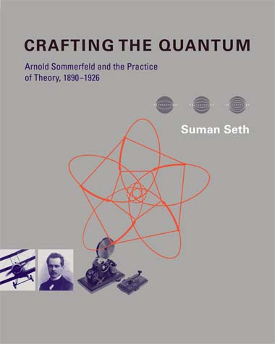
For further details…

